Slide 1
Triangulating Consciousness
pitfalls and Feedback
Ugo Bruzadin Nunes, PhD

Slide 2
Index
Overview
NCCs
Methods
IB, BM, DCF
Projected Analyses
Pilot tests results
Time Decoding + Temporal Generalization
Time-frequency Analysis
Compound Analysis

Slide 3
Introduction: The Neurocorrelates of Consciousness
The set of minimal neuronal events jointly sufficient for a given conscious experience (Koch, 2003)
Generally, NCCs are derived from experiments with 1 task, in which participants report immediately or delayed (Lepauvre & Melloni, 2021)
However, task-related, report-related and post-perceptual neural signals may be confounds to true NCCs (Pitts et al. 2014, Schroeder et al., 2021).
For example, recently Pitts et al. 2014 showed that the P3b, once thought to be a NCCs, was not present during a no-task inattentional blindness paradigm.

Slide 4
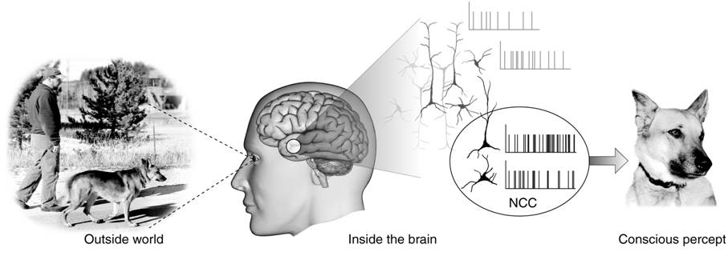
Introduction: The Neurocorrelates of Consciousness
Not all stimuli are processed equally by the brain
Some stimuli are experienced and could theoretically be responded to (seen), some are just never experienced (blinded).
When the stimulus is task relevant, or when you respond to a stimulus, those stimuli are more than just conscious

Slide 5
Introduction: The Neurocorrelates of Consciousness
In order to remove confounds from the analysis, we set to analyze three no-report tasks, with the same stimuli, but different mechanisms to induce visual (un)awareness.
The project is data-driven, where we analyze the data in an unbiased manner, using machine learning to find the signals that are present in all three tasks
We are also investigating 5 candidates for NCCs, including N140, P3b, Alpha suppression, late gamma bursts, and stability of activity patterns

Slide 6
Targeted Problems
How do you distinguish between a true NCC, and task- and report-related cognition?
How can I know which neural signal is a true NCC, and not a product of one particular task?
Can it be possible for a ML to learn from one task and generalize to another?
What can we learn from the ML about our NCCs?
Can we replicate these findings in different labs?

Slide 7
The Tasks
Backwards
Masking
Very different approaches to manipulation of awareness
Can be performed with same stimuli
Can be performed without report
NCCs
Inattentional
Blindness
Dichoptic
Color Fusion

Slide 8
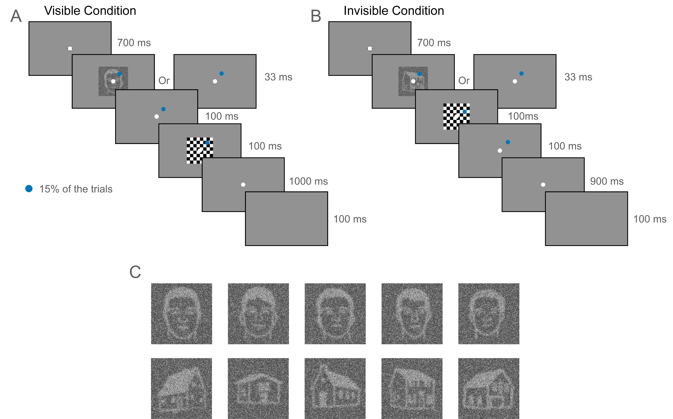
Backwards Masking
Main task: in 15% of the trials, participants are instructed to click whether there is a blue circle in the screen.
Conditions:
25 ms SOA (invisible)
100 ms SOA (visible)
Phase 1: No-report
Phase 2: Report
Examples of the stimuli and different trial types in the backward masking experiment. Face and house stimuli (or blanks) will be presented for 33ms, followed by a 100ms blank screen and then a 100ms mask (A: visible condition) or a 100ms mask and then a 100ms blank screen (B: invisible condition). On 15% of the trials, a small blue disk will be presented at a random location subtending the same area of the screen as the critical stimuli, and will serve as the task-relevant targets while the faces and houses will remain attended (spatially & temporally) but task-irrelevant. Examples of the face and house stimuli are shown in panel C.

Slide 9
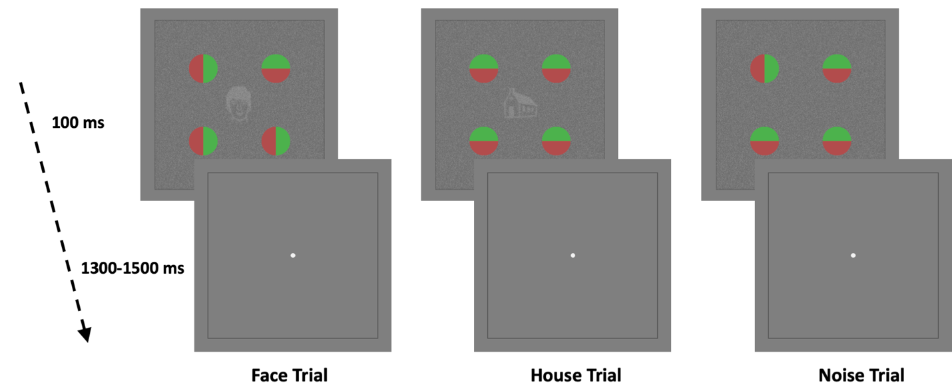
Inattentional Blindness
Main task: identify whether the circles are or are not facing the same direction
In the center, a face , house, or nothing is shown
Divided in 3 phases
Phase 1: “Blinded”
Phase 2: Not-blinded
Phase 3: Report
Face/Hose/Noise stimuli will be presented centrally at fixation for 100ms, together with four red/green circles presented in the periphery. In the example shown here, the top right circle is rotated in the face trial, and the bottom left circle is rotated in the noise trial, while the house trial shows an example of the circles oriented the same. In phase 1 and 2 subjects will perform a task on the color-bisected circles and in phase 3 they will discriminate faces/houses/noise. The physical stimuli will remain identical across all three phases.

Slide 10
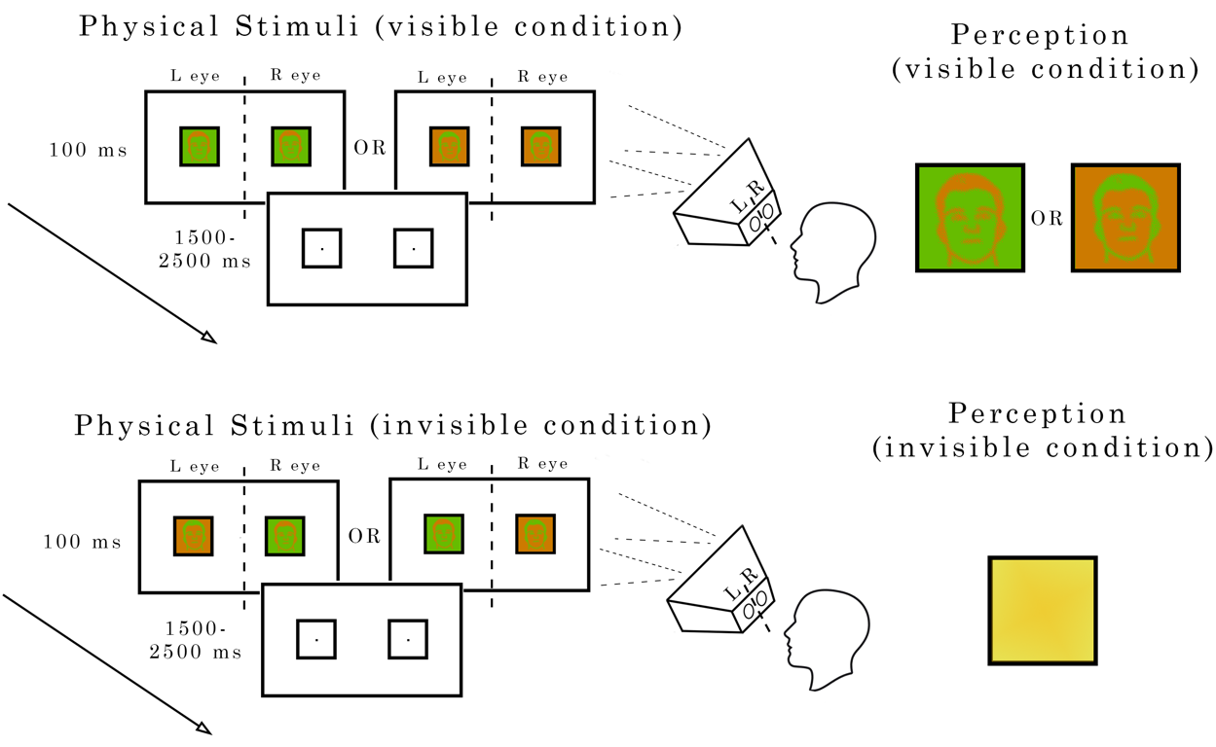
Dichoptic Color Fusion
Main task: in 15% of the trials, participants are instructed to click whether there is a blue circle in the screen.
Conditions:
Congruent stimuli (visible)
Inverse stimuli (invisible)
Phase 1: No-report
Phase 2: Report
Examples of stimuli and the different trial types in the dichoptic color fusion experiment. Face and house stimuli (or blank control stimuli) will be presented for 100ms in the same color configuration to both eyes (top panel: visible condition) or in opposite color configurations to the left and right eye (bottom panel: invisible condition). On 15% of the trials, a small blue disk (not shown here) will be presented at a random location on the same area of the screen as the critical stimuli, serving as the task-relevant target, while the faces and houses will remain task-irrelevant.

Slide 11
Proposed analysis
Time Decoding + Temporal Generalization
Time-frequency Analysis
Deep learning
Compound Analysis of other potential NCCs

Slide 12

The Pipeline
MATLAB:
Preprocess the data following pre-determined protocol
Split the data train and test parts (for kfold cross-validation, 5 parts)
Subtract the mask from Backwards Masking
Extract/Export epochs
Python:
Import and organize the data cube and ID arrays for experiment, phase, stimuli, test/train.
Created a structured way to train and test different sets of the data
Created the time-sliding window script that allows to run any ML or NN, an any given window sizes, step sizes, and any data manipulation necessary, training and testing at all windows
Save outputs and print results
data

Slide 13
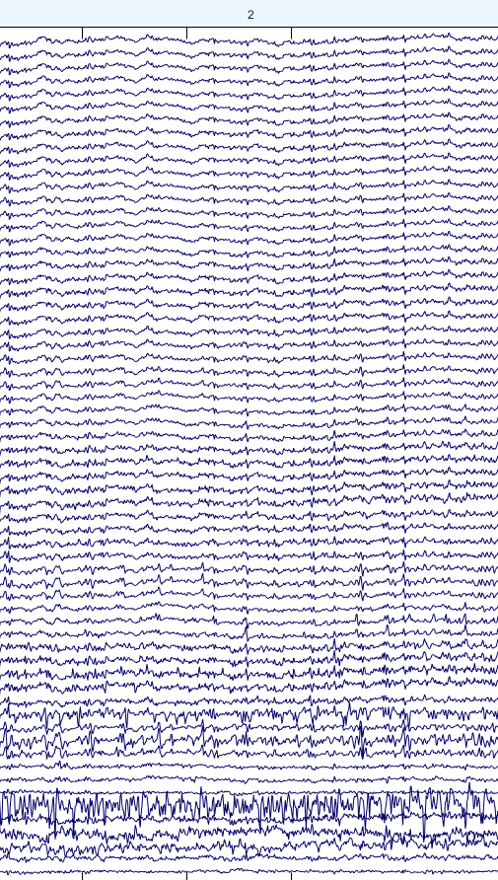
Time-Decoding
Because this is a data-driven experiment, a few files were separated to test and identify the best decoder and hyperparameters.
I created a pipeline to allow me to “quickly” test various ML algorithms and hyperparameters, analyze and plot the results.
Decoding: “Seen” vs “Unseen”
Combined faces and houses for analysis
Create 15-trial-average pseudo-trials
Sliding window (10ms steps, 40ms window)
Using ROC-AUC as a measure of accuracy
5-fold Cross-Validation
Avg. Bootstrapped C.I. for significance
Channel
Trial
Time

Slide 14
Methodology progression
“Big soup” vs round-robin: train all test all, vs train 2 test 1.
Big Soup model
Issues: hard discerning source of the “decodability”
Solution: also test individual tasks after training all
Machine Learning
Machine Learning
Train
Train
Train data
IB
BM
DCF
Train data
IB
BM
DCF
Test
Test
Test data
IB
BM
DCF
Test data
DCF
IB
BM

Slide 15
Methodology progression
We also decided to run a “Round Robin” model of testing
Source of decodability is known
Triangulation claims can be made
Machine Learning
Train DC
Test DC
Train DC
Test IB
Train DC
Test BM
Train
Train data
DCF
IB
BM
Train IB
Test DC
Train IB
Test IB
Train IB
Test BM
Test
Test data
DCF
IB
BM
Train BM
Test DC
Train BM
Test IB
Train BM
Test BM

Slide 16
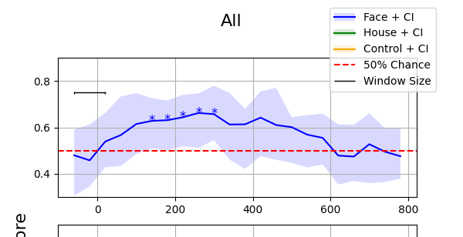
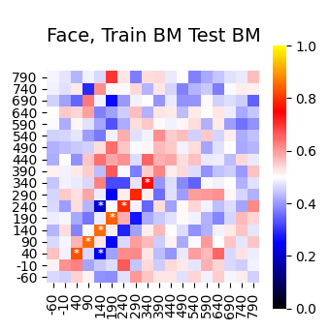
Methodology progression
Train and Test at the same time points
Sliding window for training and testing
Temporal generalization
To test whether a signal is delayed in on paradigm
Train and Test at the ALL time points
Train
Train
Test
Test

Slide 17
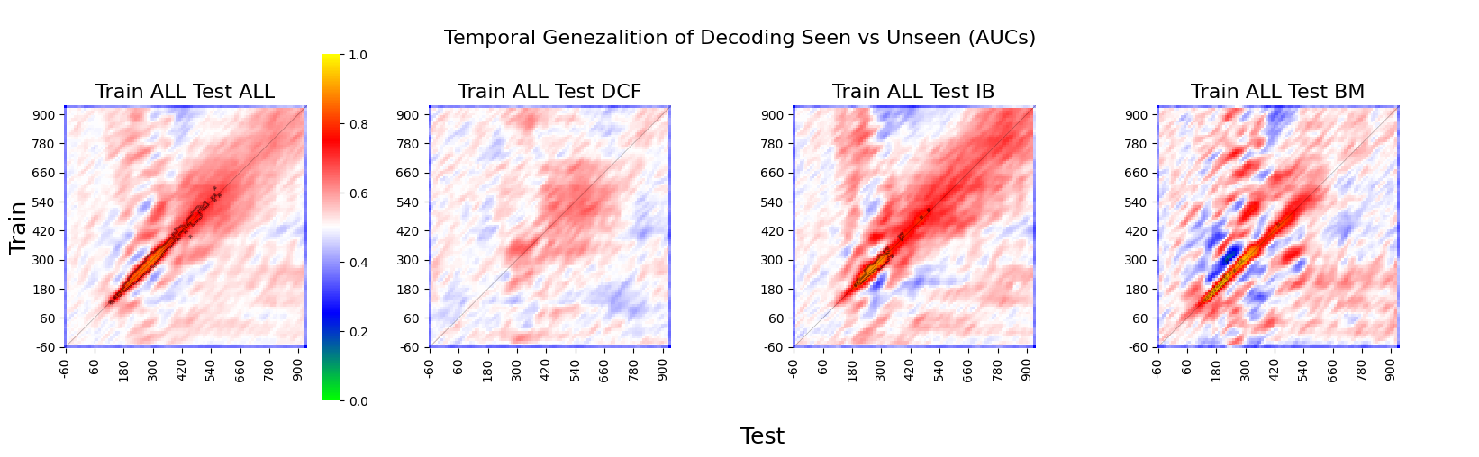
Current pilot results
Big Soup + individual tests (4 participants)
Trending significance in DCF, while reaching significance in IB and BM low C.I. > 50% and high C.I. < 50%

Slide 18
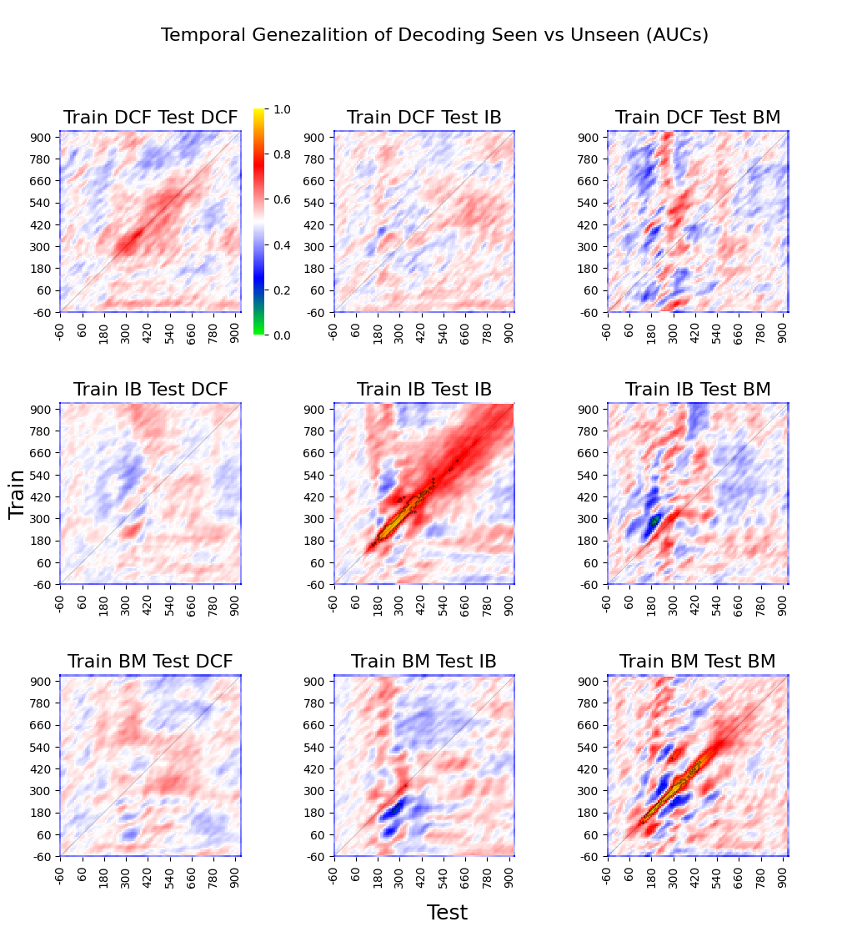
Current pilot results
Round Robin
Significant Generalization Between IB and BM (low C.I. > 50%)
Weak but significant generalization between BM and DCF
This weak DCF generalization is due to a weak visual stimulus

Slide 19
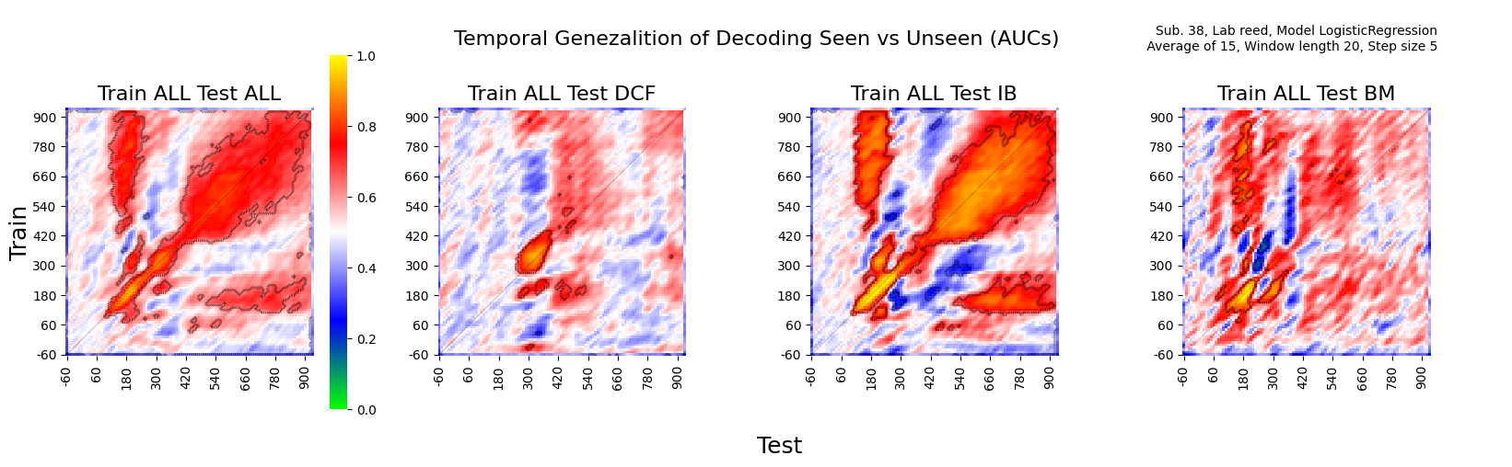
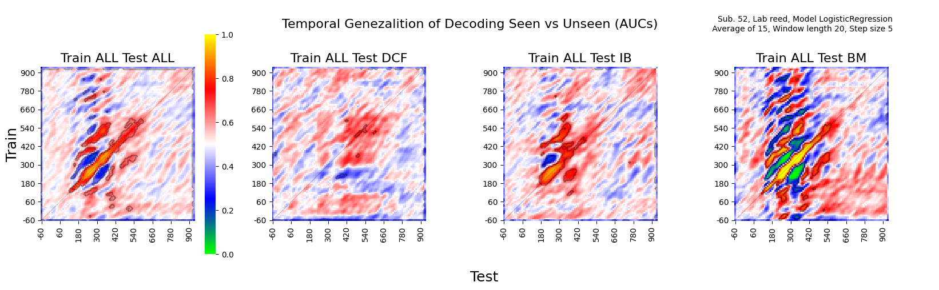
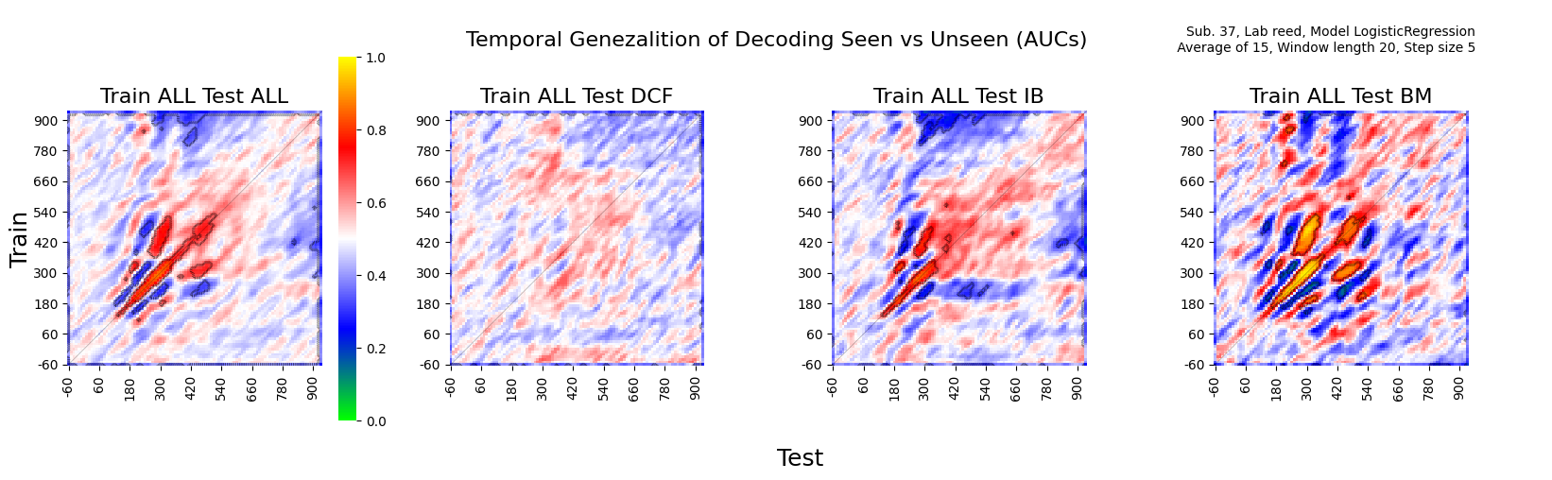
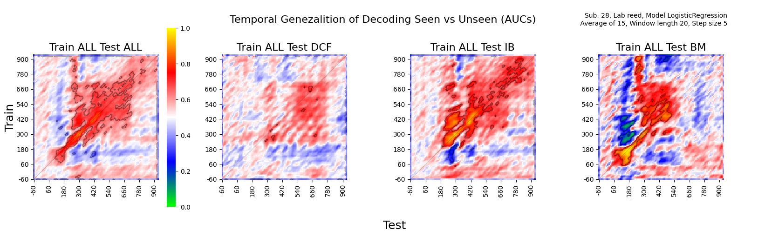
Current pilot results
Individual participants did display significant generalization between paradigms

Slide 20
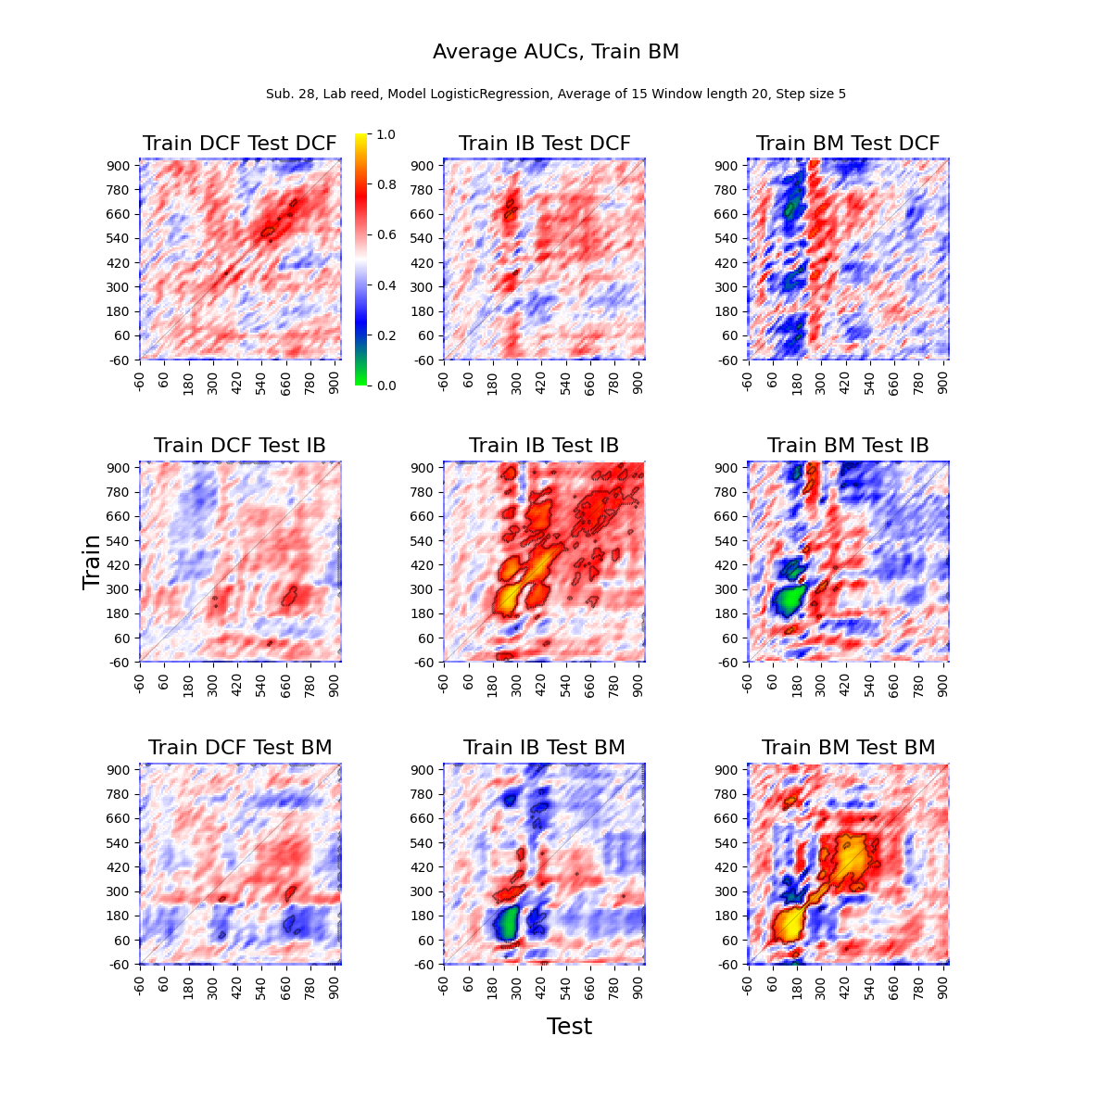
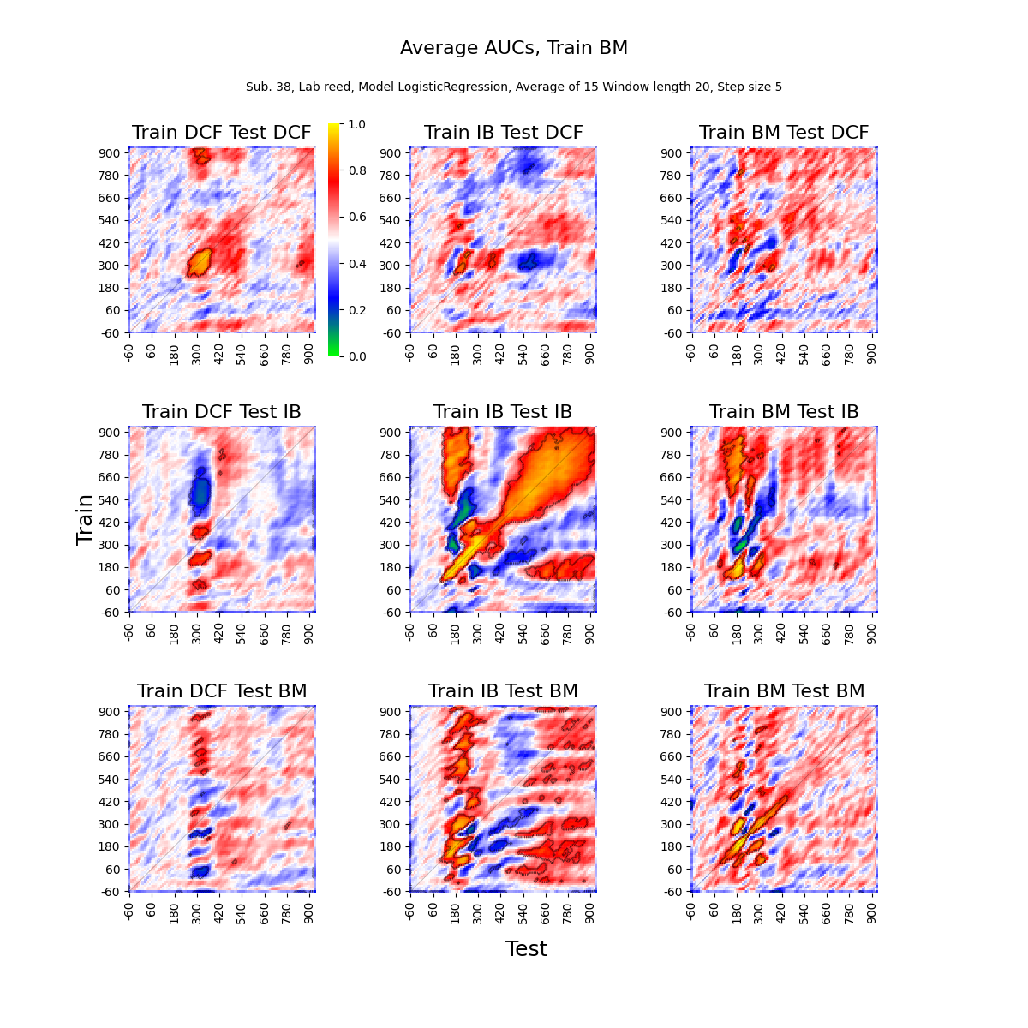
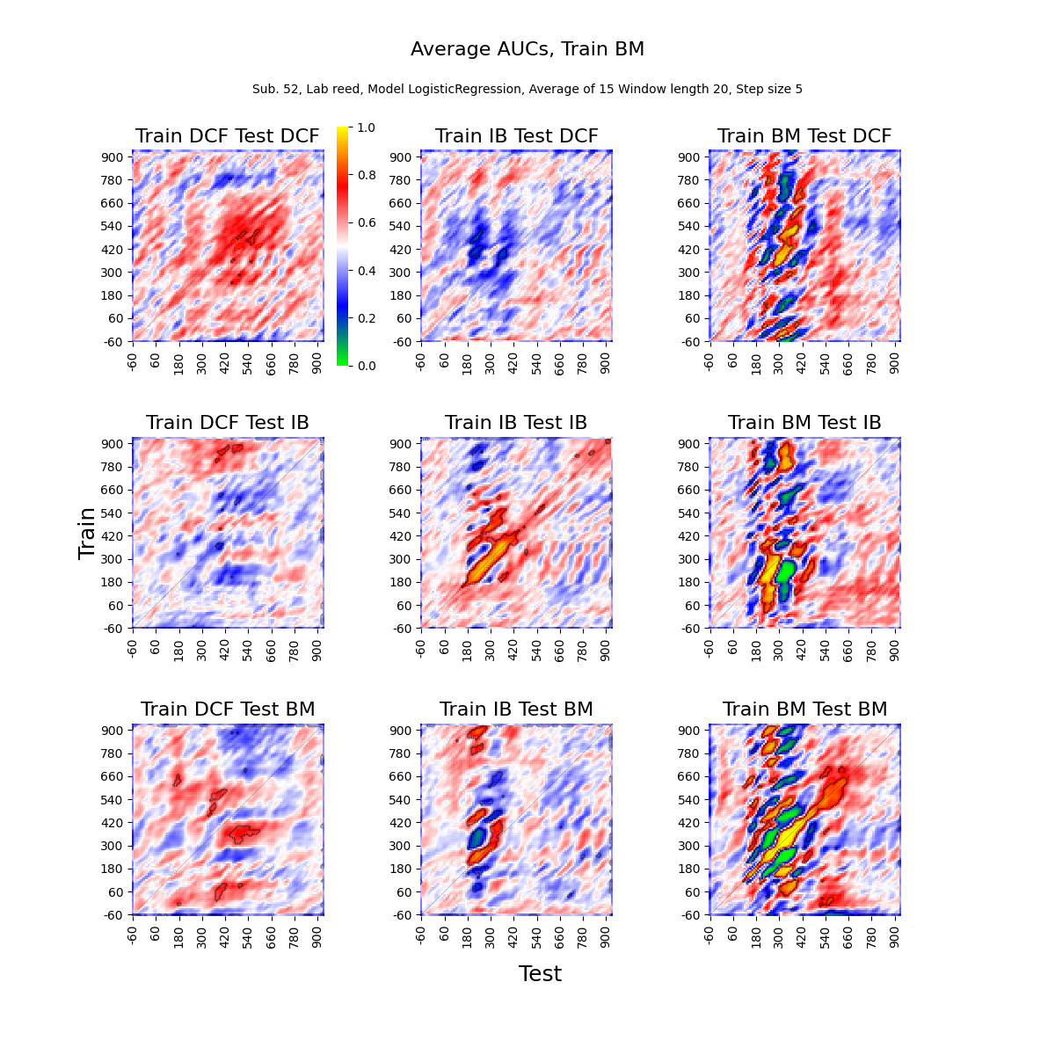
Current pilot results
Individual participants did display significant generalization between paradigms
Participant 38 had the strongest color contrast (8) as well as the strongest behavioral response in block 2 of DCF, and the strongest within-decodability in DCF

Slide 21
Discussion
Found strong signs of triangulation, with significant generalization between IB and BM
Issue with a conservative choice for DCF’s color contrast levels
In participants with decodable DCF, we observe significant generalization among all three tasks for most models
On those participants, we do observe a generalizability with the Big Soup model, not only significantly decoding a test-set without labels, but each paradigm independently.

Slide 22
Next steps
Plotting the head-model weights for the significant regions
Complete Time-frequency analysis
Open the full dataset and run the analysis on all the participants
Compound analysis of the ERPs

Slide 23
Suggestions, Comments, Questions?

Slide 24








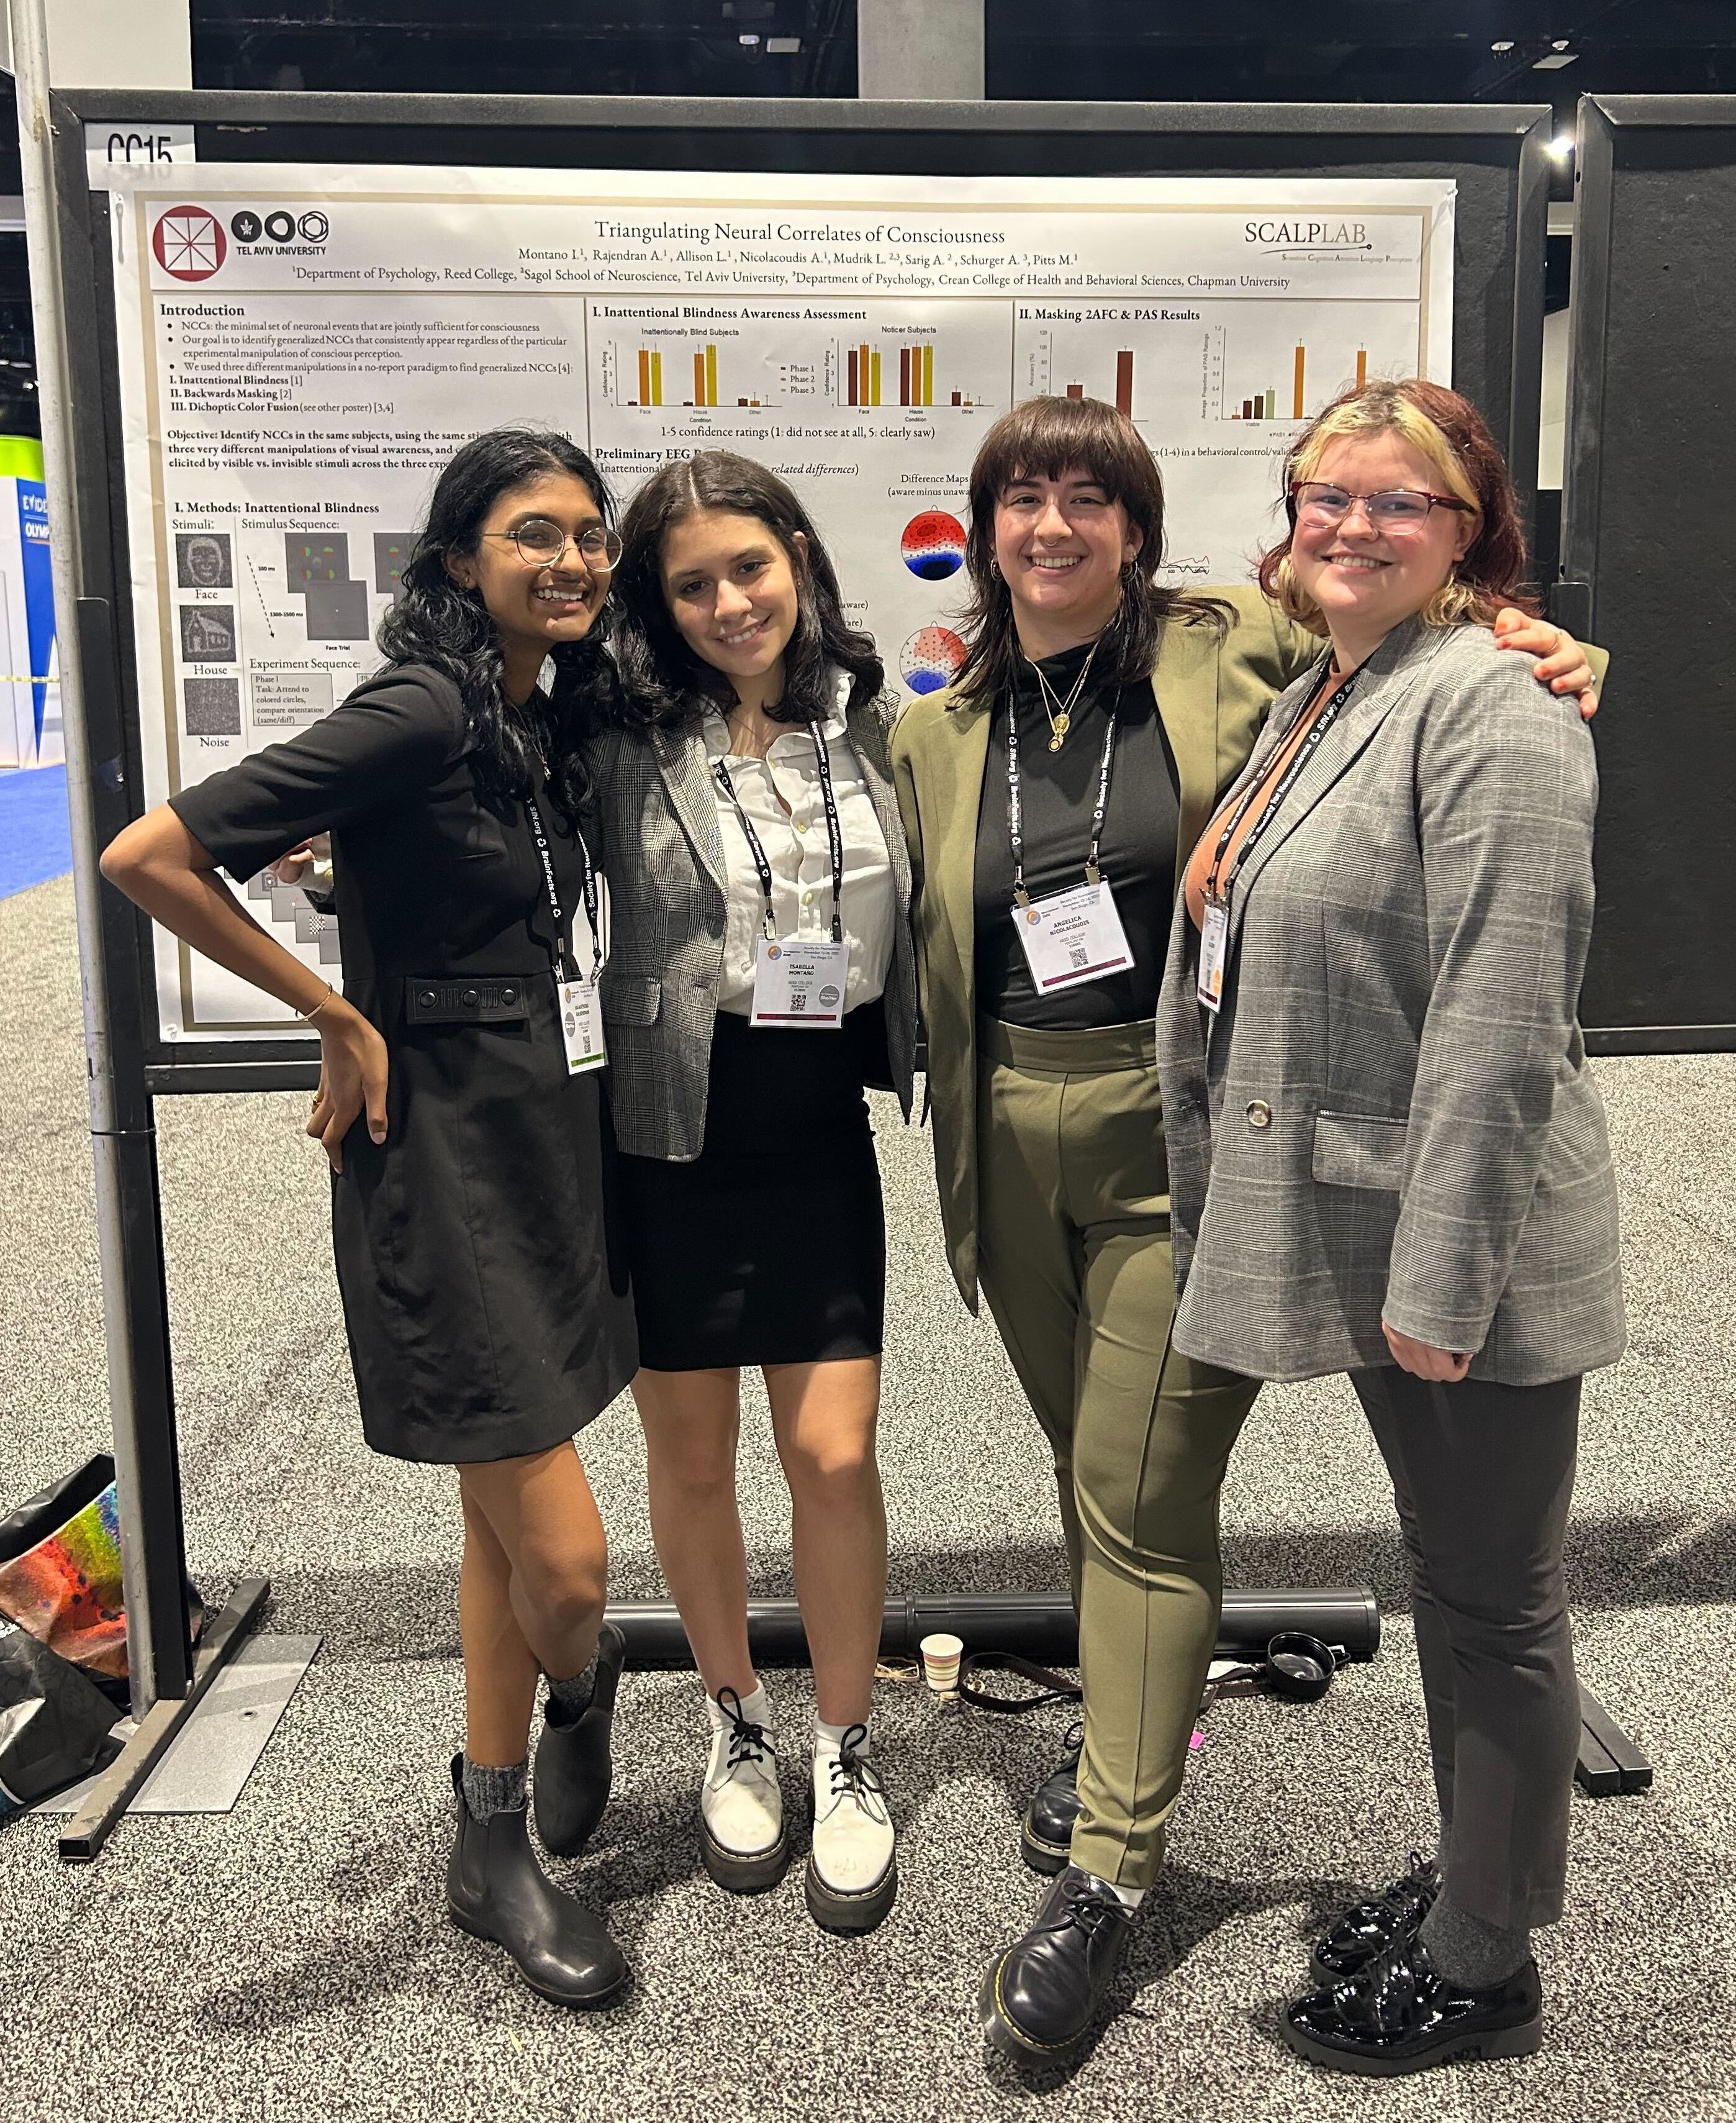


Acknowledgements
Grant 30266: https://doi.org/10.54224/30266
Dr. Aaron Schurger
Dr. Michael Pitts
Dr. Liad Mudrik
Sarah Quach
Angelica Nicolacoudis
Adi Sarig
Nell Racabl

Slide 25
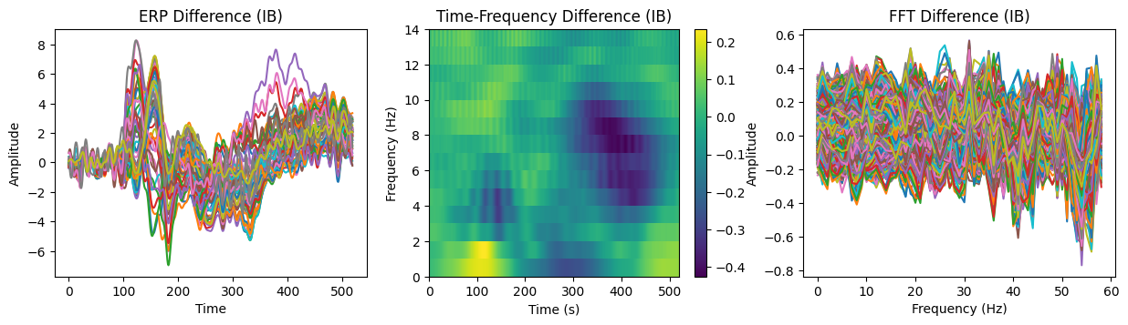
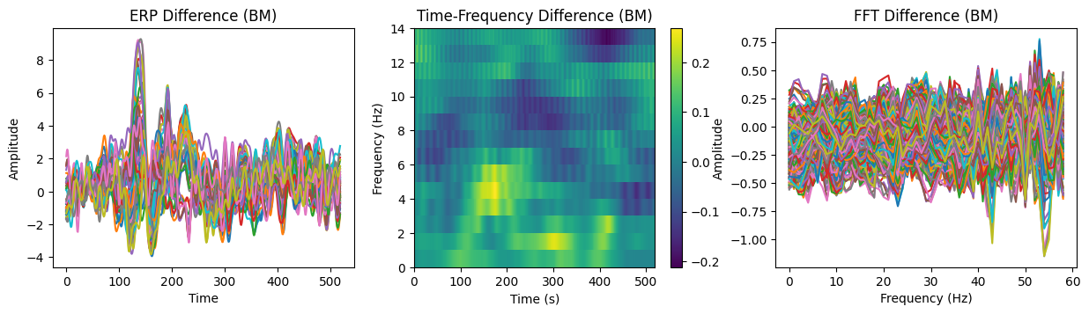
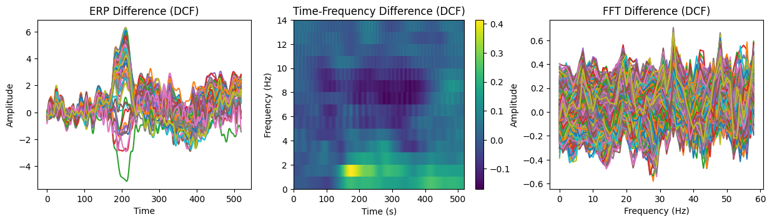
Sub 38
Seen - Unseen

Slide 26

Candidates to NCCs?
Perceptual Awareness Negativity (Dembski et al., 2021)
N140 VAN/AAN
alpha suppression [30]
late gamma bursts [31], generalization of decoding during “cortical ignition” [32], and stability of neural activity patterns [16].

Slide 27
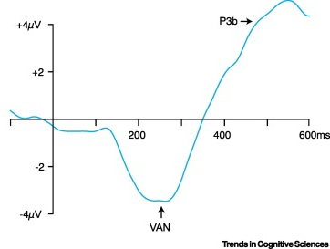
Late Positivity or P3B
A robust signal, present only under conscious conditions (Dembski, Koch, Pitts, 2021, Verleger, 2020)
However, the signal is not robust in patients with disorders of consciousness (Perrin et al., 2006, Sitt et al, 2014, Fischer et al., 2010)
Evidence points towards P3B being related to secondary cognitive processes:
It is present in complex but not simple perceptual tasks (Derda et al., 2019)
When stimuli expectations is not yet formed (Melloni et al., 2011)
When reporting, but not when not reporting (Pitts et al., 2014)
And only when it is task relevant (Schlossmacher et al., 2021)
Image taken from Dembski et al., 2021)

Slide 28
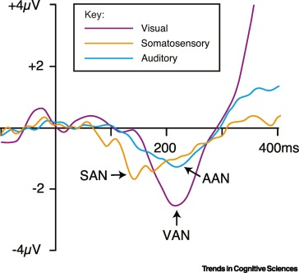
Perceptual Awareness Negativity

Slide 29
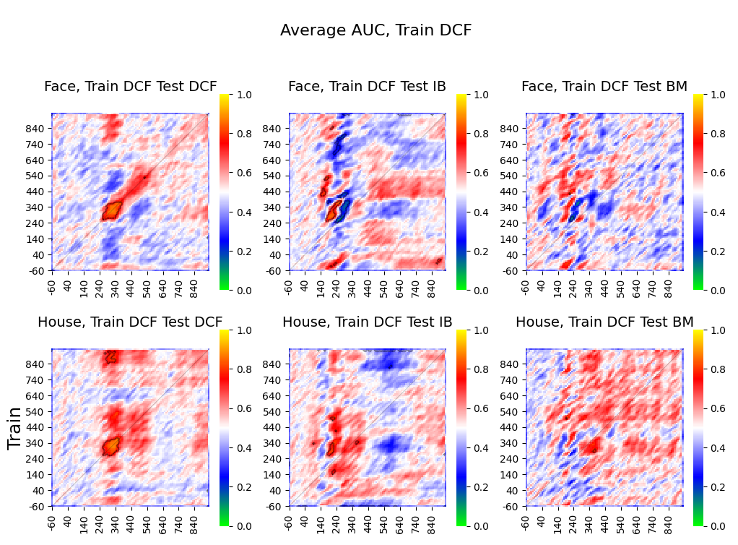
Current pilot results

Slide 30
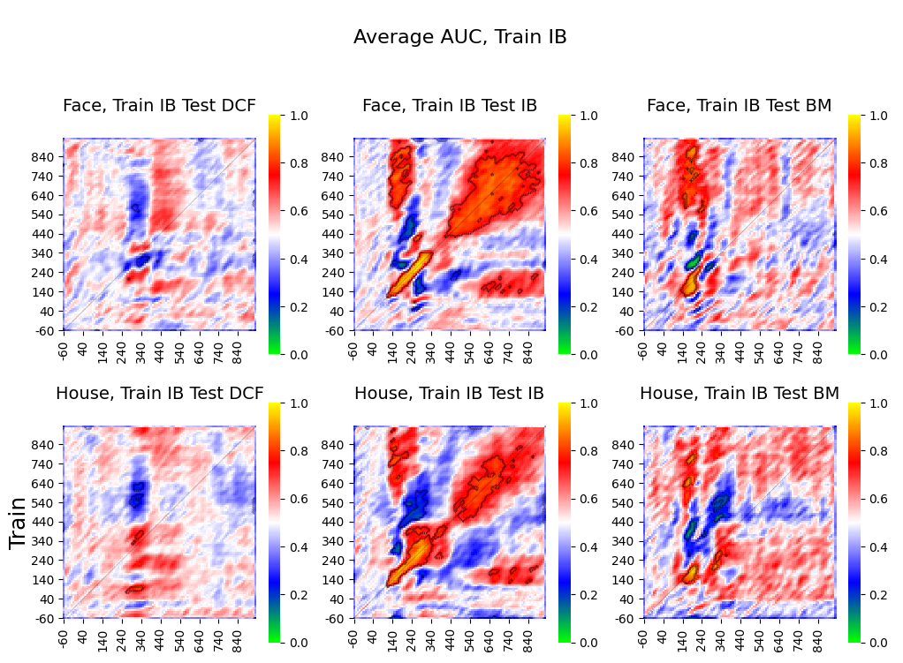
Current pilot results

Slide 31
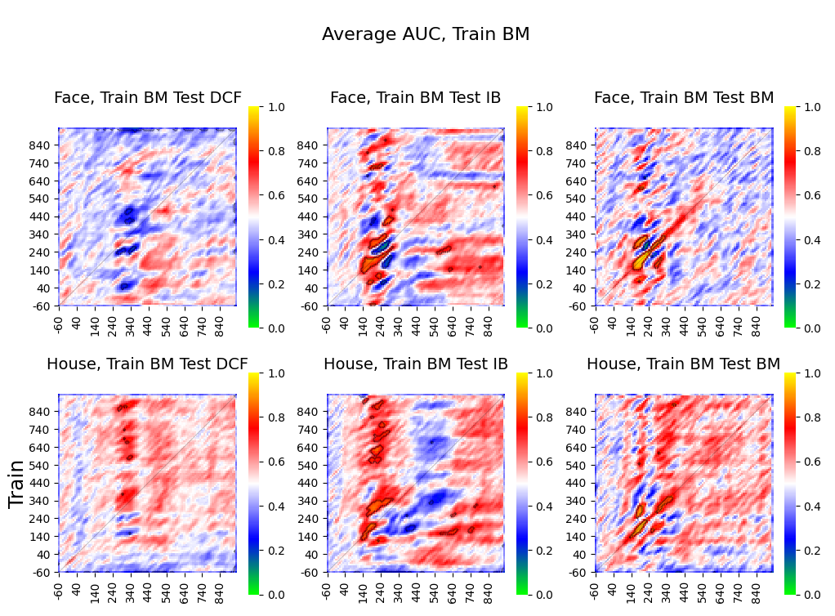
Current pilot results

